Slide 1
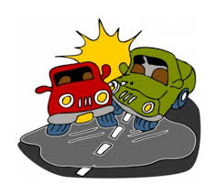
Motor Vehicle Crashes
Santosh Muniswamygowda Nagaraja
ID- 1015433

Slide 2

Map Reducing Programming
Map Reduce programming can be used to First understand the data set by performing simple operations such as the following.
We can determine the total number of casualties in the span of 3 years
There are 2 different types of contributing factors for each accident in the given data set.
- Contributing factor 1 and Contributing factor 2
We can determine which is the major contributing factor for the accidents.
We can determine which contributing factor has caused more casualties
We can determine which city has more number of drivers, driving on influence.

Slide 3
Spark
One of the main advantages of using spark is to determine patterns in the data set.
We can use the data set to find different patterns in the data set such as the following.
We can determine which car model has contributed more to accident factor 1 or accident factor 2.
We can determine which city has more traffic violation accident.
The data set consists of the driver’s action prior to accident. With this information we can determine how does the tend to driver react prior to the accident.
We can determine if there is any faulty traffic electronic device in a city that might be contributing to the accident.

Slide 4
1 Hive or Pig
Hive can be used to write SQL like queries for the database with the help of this we can determine various features of the data set such as:
We can list the top 10 contributing factor of the accidents
We can list the top cities where the vehicles are violating the speed limit and are resulted in accidents.
We can determine if there is a pattern of accident in a particular place due to mis guided traffic electronics.
We can determine if a particular car model has caused more number of accidents, this might be due to a improper manufacture of the car model.
The data can be downloaded from the following link provided the New York state police Dept
Link - https://catalog.data.gov/dataset/motor-vehicle-crashes-vehicle-information-beginning-2009

Slide 5
THANK YOU

